Slide 1
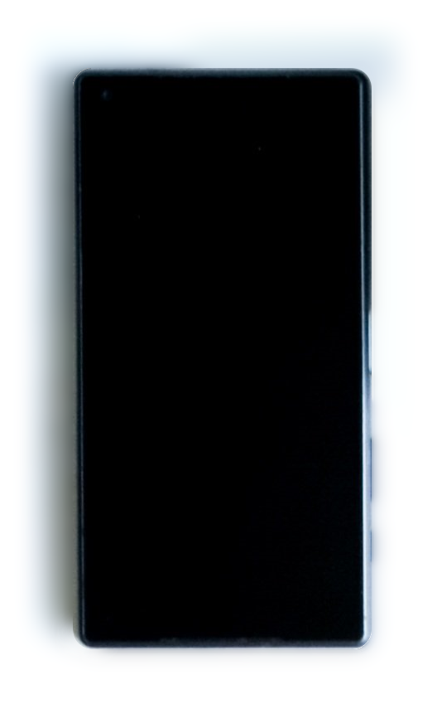
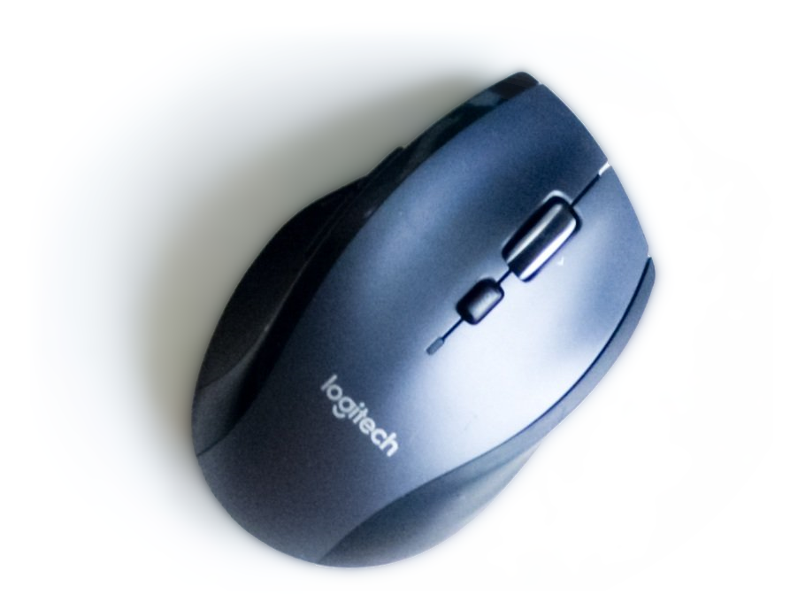
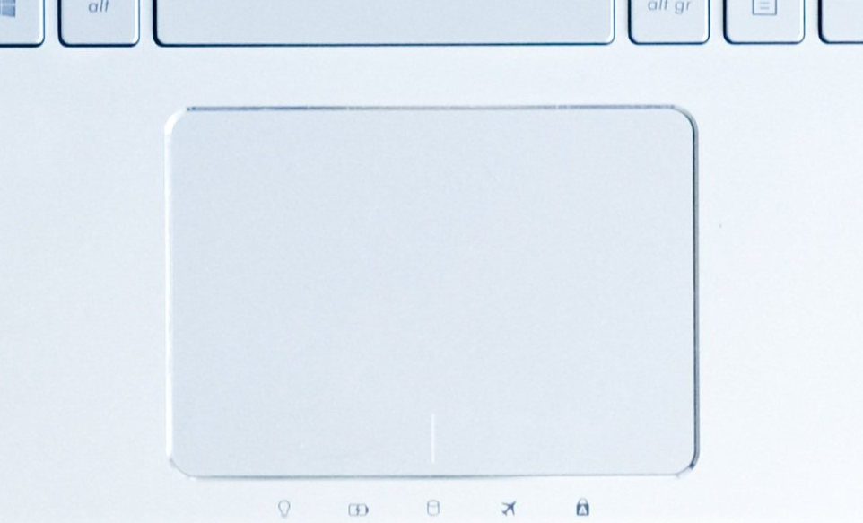
Applications of Fitts’ Law
From https://www.pexels.com/photo/woman-sitting-in-vehicle-3007318/
Images adapted from https://pixabay.com/de/photos/computer-laptop-arbeitsplatz-maus-2982270 by Skitterphoto

Slide 2
Learning Goals
Know how to extend Fitts’ Law to two dimensions
Understand how Fitts’ Law can be helpful for HCI
Being able to compare input devices using throughput
Applications of Fitts’ Law

Slide 3
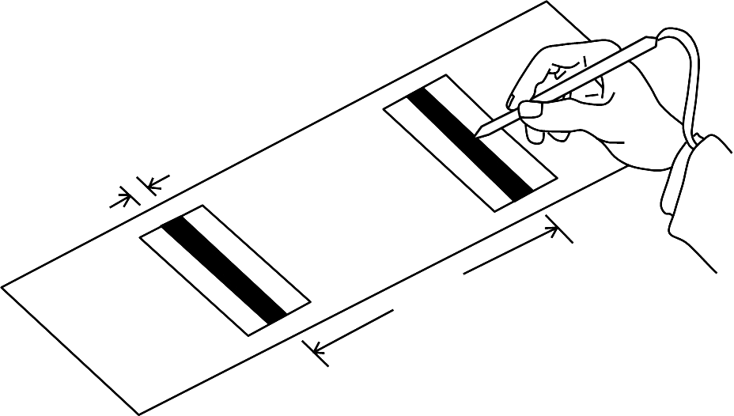
Fitts used one dimensional pointing tasks
Applications of Fitts’ Law

Slide 4
Typical targets are two-dimensional
distance
width
Applications of Fitts’ Law

Slide 5
Determining D and W for 2D targets
distance
width
What are width and distance?
Applications of Fitts’ Law

Slide 6
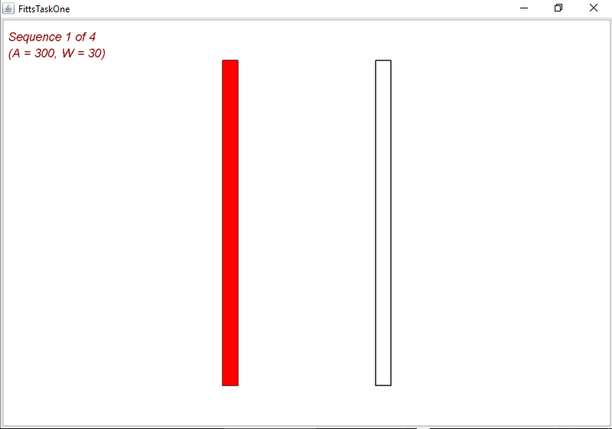
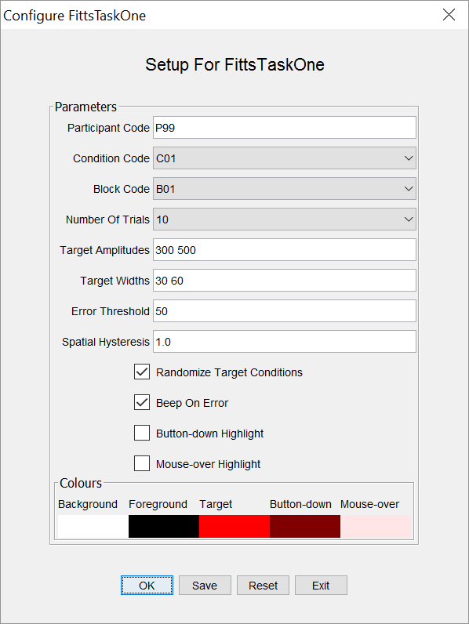
1D Fitts’ Law tasks for computers
By Scott MacKenzie from http://www.yorku.ca/mack/
Commonly using a fixed set of amplitudes and Widths, e.g.:
Amplitude (A): 64, 128, 256, 512 pixels
Width (W): 8, 16, 32, 64 pixels
Applications of Fitts’ Law

Slide 7
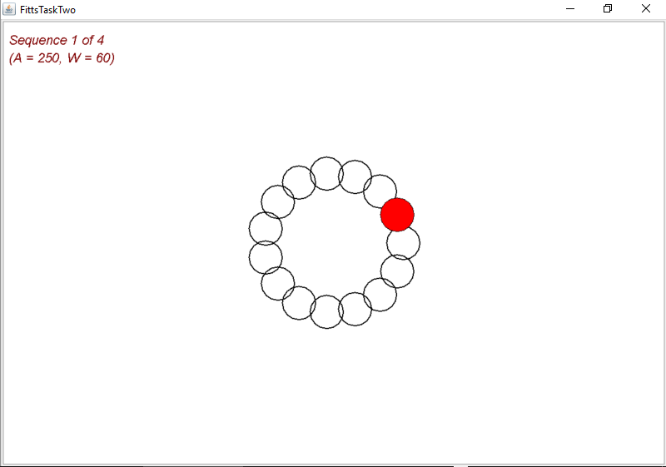
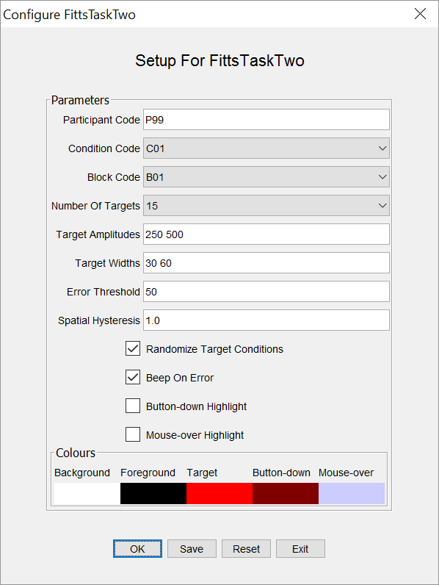
1D Fitts’ Law tasks for computers
By Scott MacKenzie from http://www.yorku.ca/mack/
Commonly using a fixed set of amplitudes and Widths, e.g.:
Amplitude (A): 64, 128, 256, 512 pixels
Width (W): 8, 16, 32, 64 pixels
Applications of Fitts’ Law

Slide 8
Comparing interfaces
Applications of Fitts’ Law
Notes:
Bigger buttons
e.g. web links
e.g. check / radio boxes
Proportional to amount of use?!
See principle (and golden rule) of consistency!

Slide 9
Context menus
Applications of Fitts’ Law
Notes:
Use current location of the cursor
distance is close to zero

Slide 10
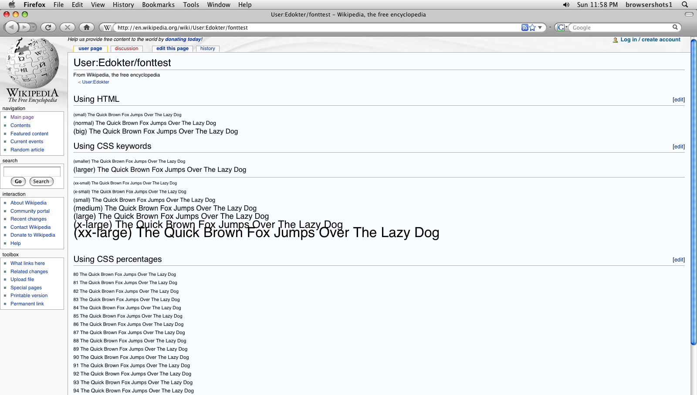
Use edges
Image based on https://en.wikipedia.org/wiki/File:Wikipedia-fonttest-firefox-3.0.1-mac-os-x-10.5.png by Quiddity (CC BY-SA 3.0) and https://www.pexels.com/photo/silver-imac-on-white-wooden-desk-3740288/ by bongkarn thanyakij (PD)
Applications of Fitts’ Law
Niels Henze
Notes:
Use edges and corners
edges of the screen have infinite height or width, respectively
corners have infinite height and width

Slide 11
Use corners
Applications of Fitts’ Law
Notes:
Use edges and corners
edges of the screen have infinite height or width, respectively
corners have infinite height and width

Slide 12
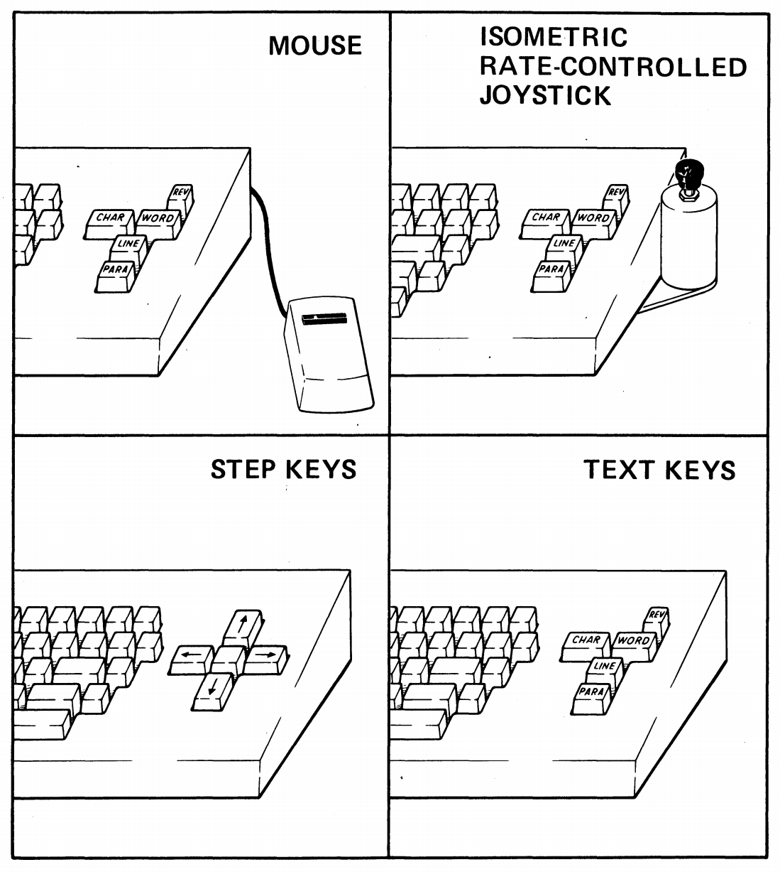
Success of the mouse
Using Fitts’ Law “was a major factor leading to the mouse's commercial introduction by Xerox”
http://www2.parc.com/istl/groups/uir/people/stuart/stuart.htm
Image from Card, S. K., English, W. K., & Burr, B. J. (1978). Evaluation of mouse, rate-controlled isometric joystick, step keys, and text keys for text selection on a CRT. Ergonomics, 21(8), 601-613.
Applications of Fitts’ Law
Notes:
Card, S. K., English, W. K., & Burr, B. J. (1978). Evaluation of mouse, rate-controlled isometric joystick, step keys, and text keys for text selection on a CRT. Ergonomics, 21(8), 601-613.

Slide 13
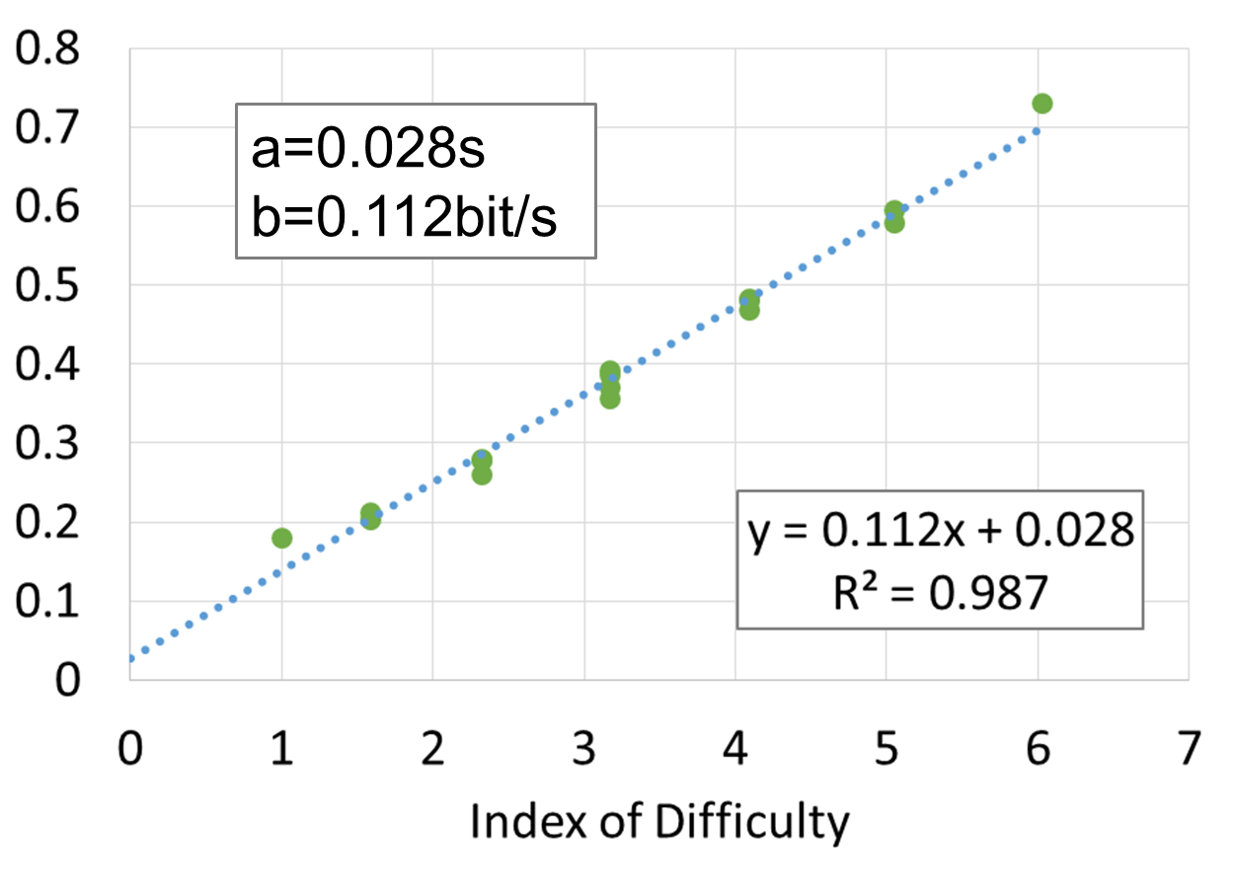
Throughput
Single metric for a pointing device
Different definition:
TP = ID / MT (average ID and MT)
TP = 1 / b (equivalent to ID / MT if a=0)
Sufficient to test 6 IDs to determine the device-specific constants a and b
6 IDs are enough to compare pointing devices
Applications of Fitts’ Law

Slide 14
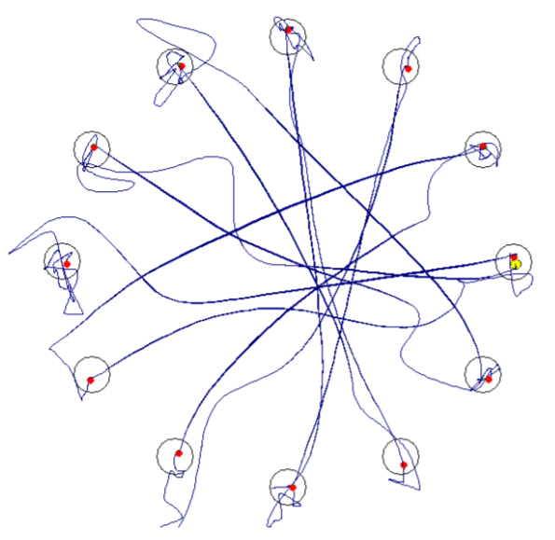
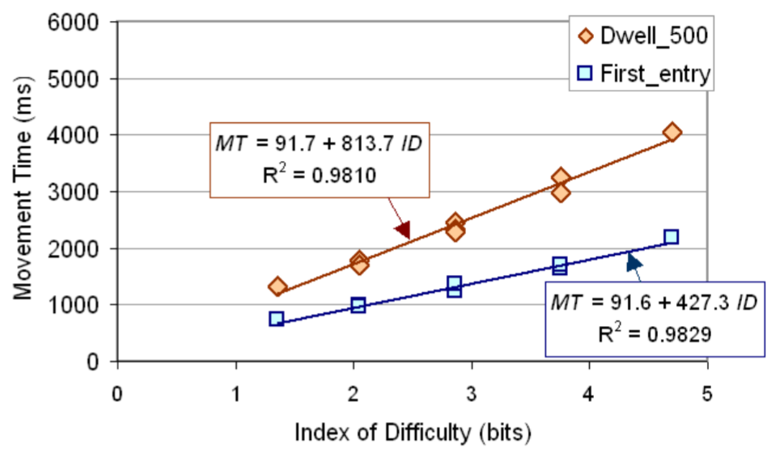
Fitts’ Law is still used to compare input devices
MacKenzie, I. S., & Teather, R. J. (2012). FittsTilt: the application of Fitts' law to tilt-based interaction. NordiCHI
Applications of Fitts’ Law

Slide 15
Other input devices
mouse
touchscreen
Which device has the highest throughput?
touchpad
Images adapted from https://pixabay.com/de/photos/computer-laptop-arbeitsplatz-maus-2982270 by Skitterphoto
Applications of Fitts’ Law

Slide 16
License
This file is licensed under the Creative Commons Attribution-Share Alike 4.0 (CC BY-SA) license:
https://creativecommons.org/licenses/by-sa/4.0
Attribution: Niels Henze
For more content see: https://hci-lecture.de

